Slide 1
Homework 5
Li Zhang
27720161153031

Slide 2
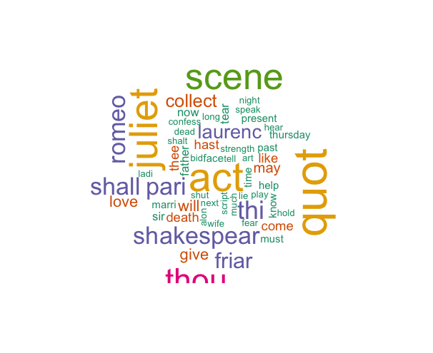
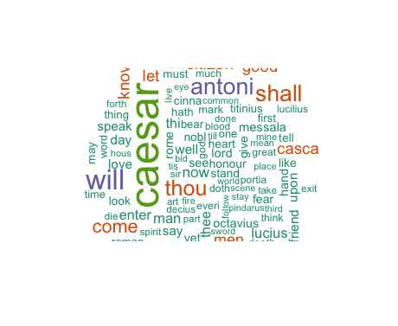
5.1 Word Cloud for Shakespeare’s Dramas

Slide 3
library(RCurl)
library(XML)
library(bitops)
library(stringr)
url="http://www.romeo-and-juliet.org/Romeo-and-Juliet-Script/romeo-and-juliet-play-script-ACT-4-SCENE-1-Friar-Laurences-cell.htm"
abs= lapply(url, FUN = function(x) htmlParse(x, encoding = "Latin-1"))
clean_txt = function(x) {
cleantxt = xpathApply(x, "//body//text()
[not(ancestor :: script)][ not(ancestor :: style)]
[not(ancestor :: noscript)] " ,xmlValue)
cleantxt = paste(cleantxt, collapse="\n")
cleantxt = str_replace_all(cleantxt, "\n", " ")
cleantxt = str_replace_all(cleantxt, "\r", "")
cleantxt = str_replace_all(cleantxt, "\t", "")
cleantxt = str_replace_all(cleantxt, "<br>", "")
return(cleantxt)
cleantxt = lapply(abs,clean_txt)
vec_abs = unlist(cleantxt)

Slide 4
install.packages("NLP")
library(tm)
library(SnowballC)
abs = Corpus(VectorSource(vec_abs))
abs_dtm = DocumentTermMatrix(abs, control = list(
stemming = TRUE, stopwords = TRUE, minWordLength = 3,
removeNumbers = TRUE, removePunctuation = TRUE))
dim(abs_dtm)

Slide 5
library(ggplot2)
library(wordcloud)
freq = colSums(as.matrix(abs_dtm))
wf = data.frame(word=names(freq), freq=freq)
plot = ggplot(subset(wf, freq>15), aes(word, freq))
plot = plot + geom_bar(stat="identity")
plot = plot + theme(axis.text.x=element_text(angle=45, hjust=1))
plot
freq = colSums(as.matrix(abs_dtm))
dark2 = brewer.pal(6, "Dark2")
wordcloud(names(freq), freq, max.words=100, rot.per=0.2, colors=dark2)

Slide 6
plot = ggplot(subset(wf, freq>1), aes(word, freq))
plot = plot + geom_bar(stat="identity")
plot = plot + theme(axis.text.x=element_text(angle=45, hjust=1))
plot

Slide 7
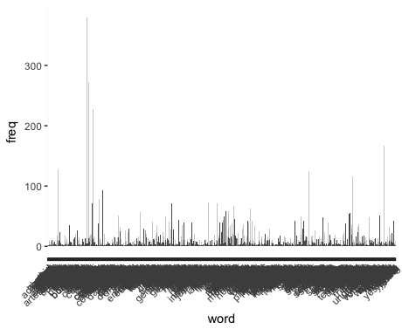
5.2 the histogram of words

